Slide 1
SHS i-zőrzők
Made by:
Szikora Norbert
Szabó Sándor Péter

Slide 2
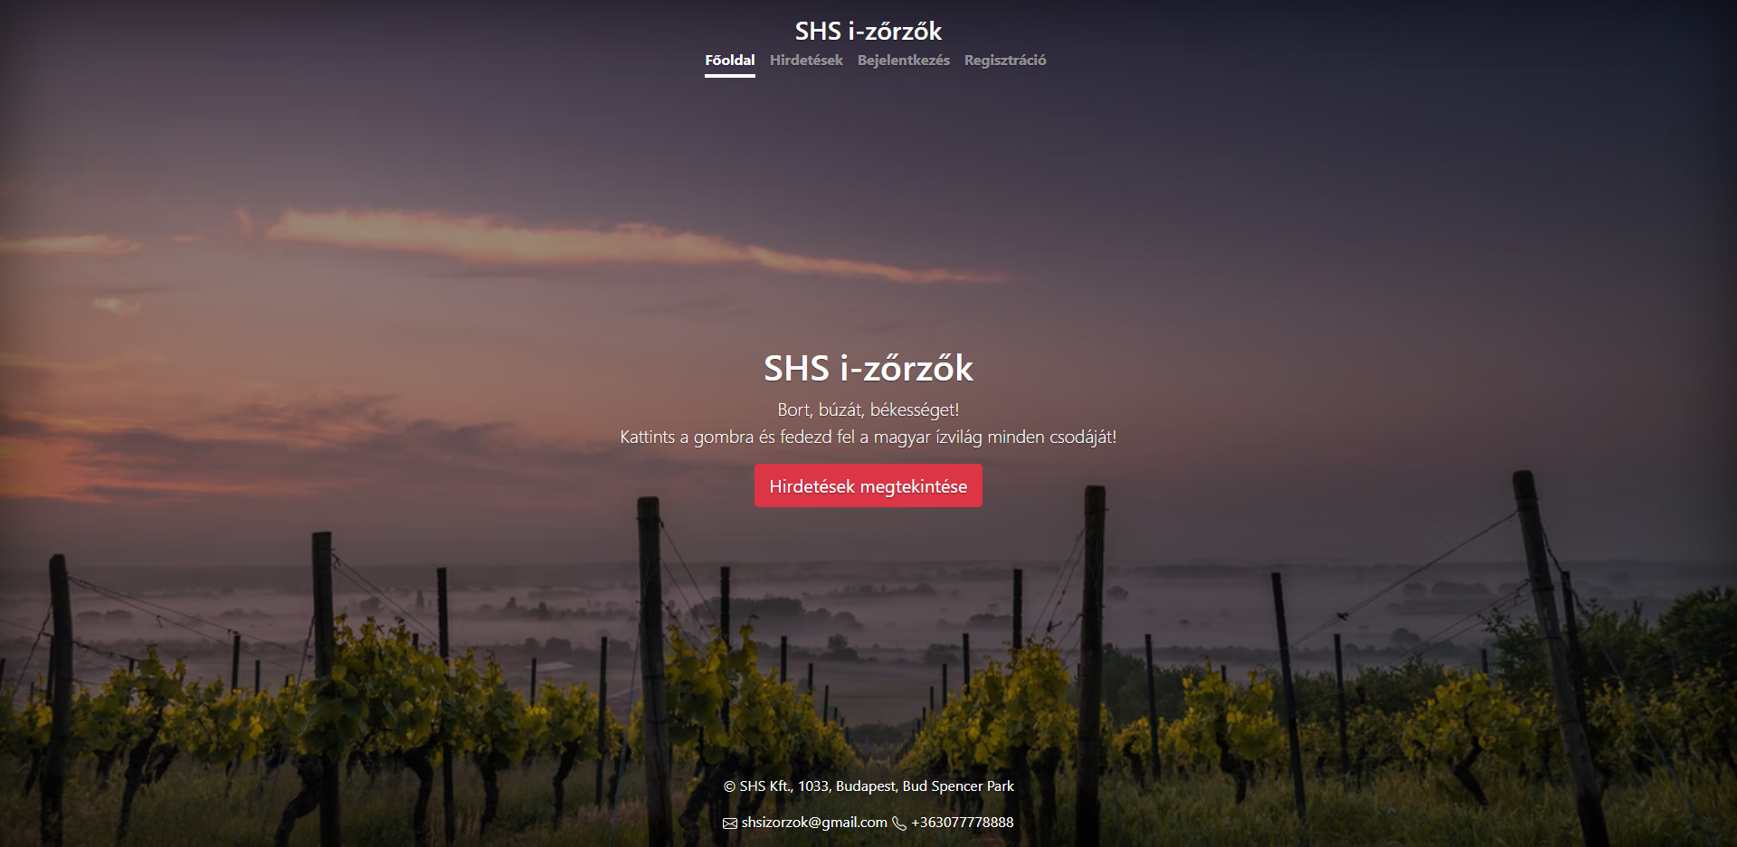
Main page

Slide 3
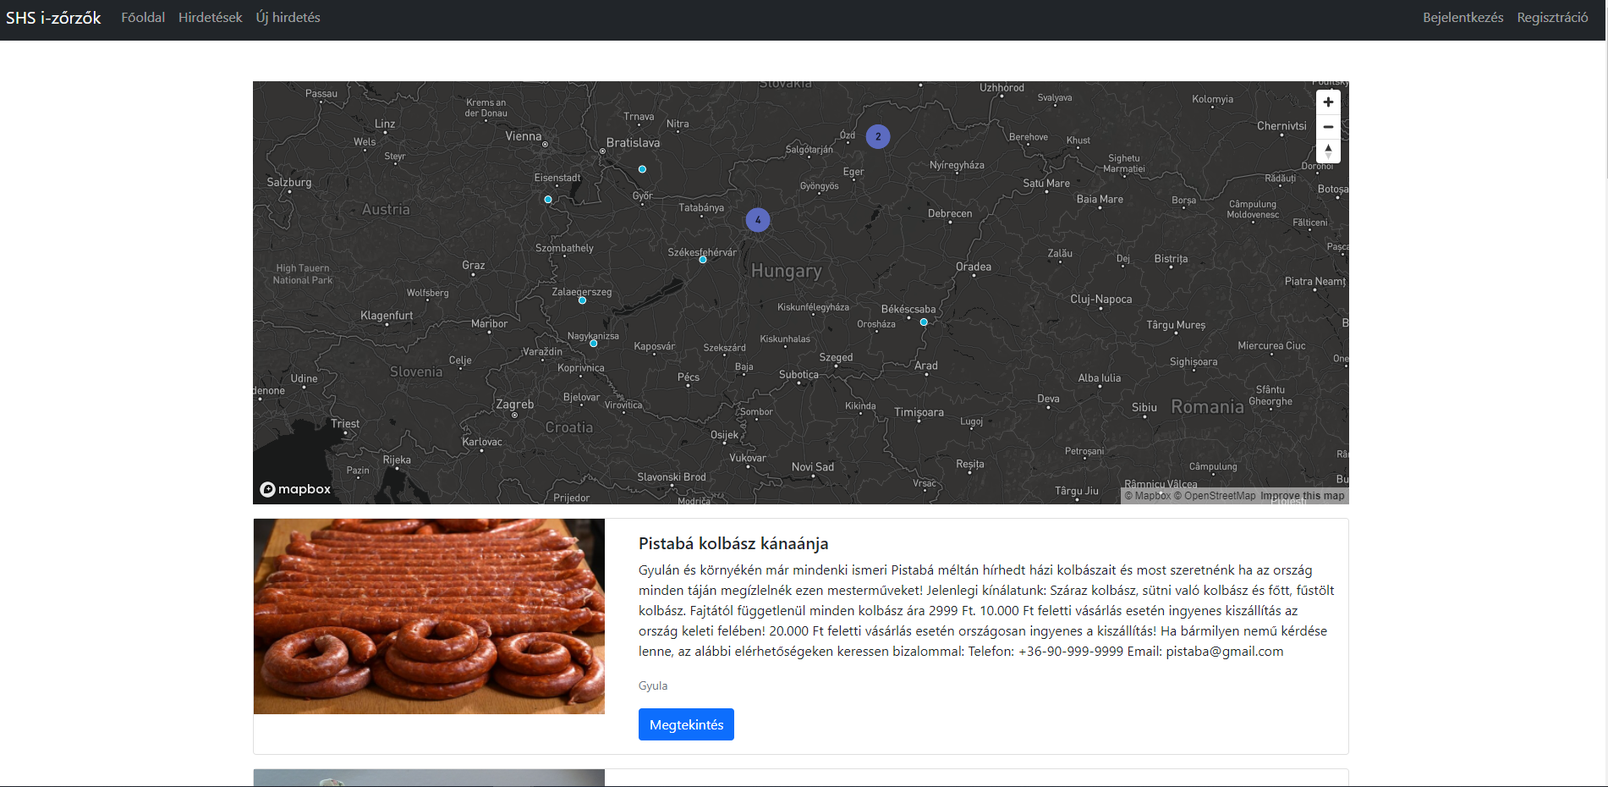
Advertising interface
Advertisements are accessible for unregistered users as well.
On the top of the page a so called cluster map can be found. Small dots mark settlements, on the other hand larger dots (clusters) cover areas.

Slide 4
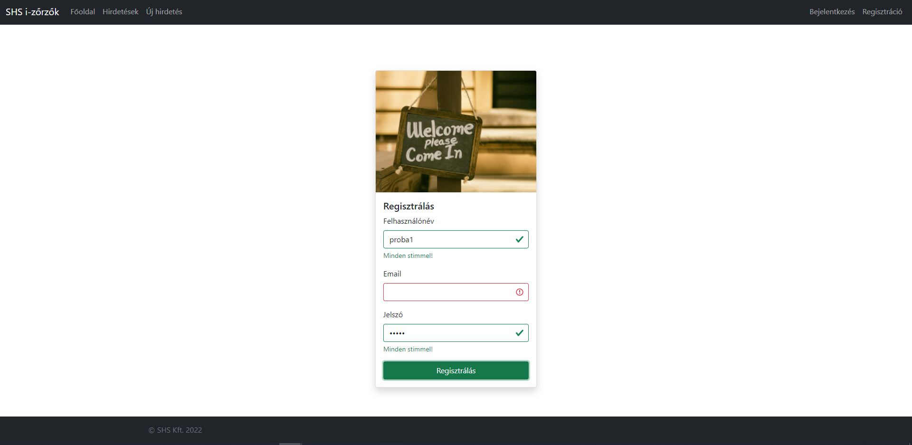
Invalid Registration
Every single field is required to be filled in order to register successfully.

Slide 5
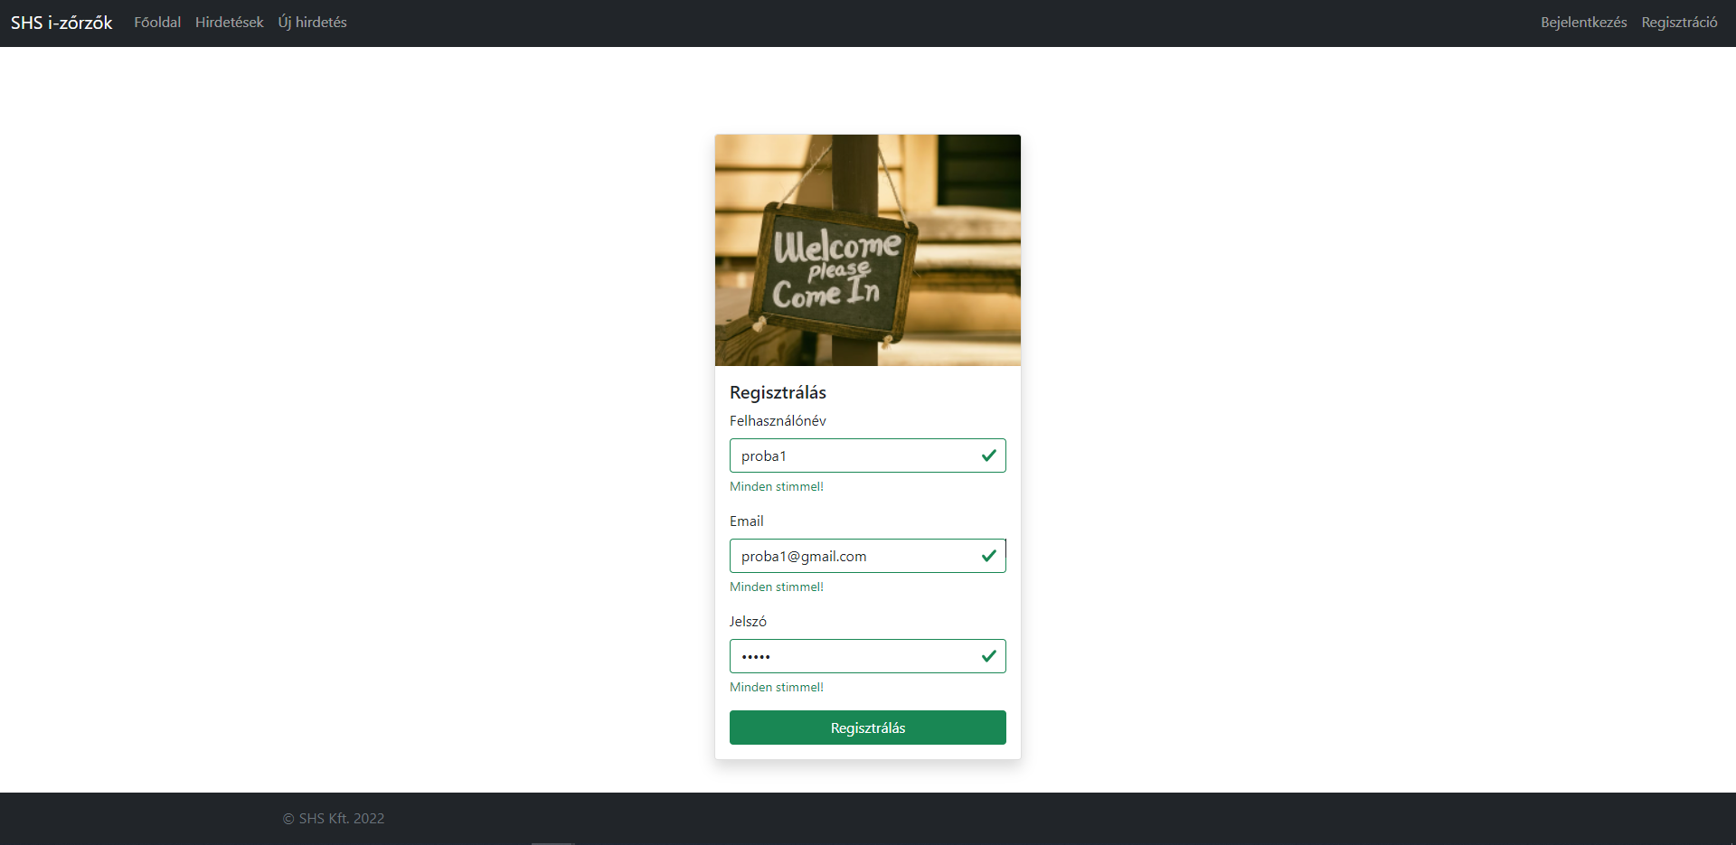
Valid registration

Slide 6
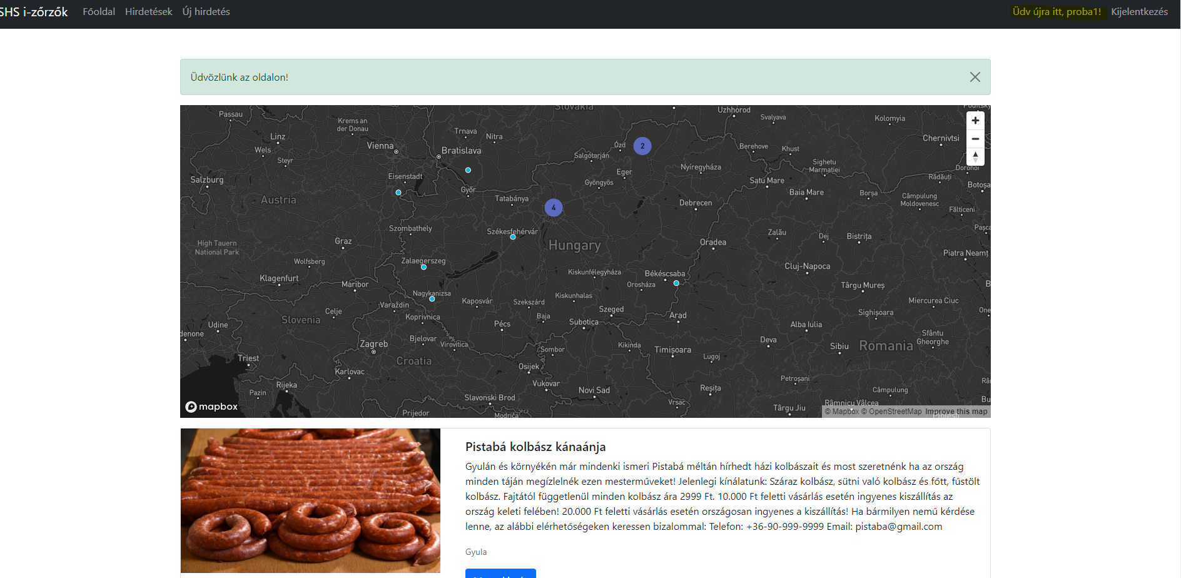
Logging in after a successful registration a welcome message greets us.

Slide 7
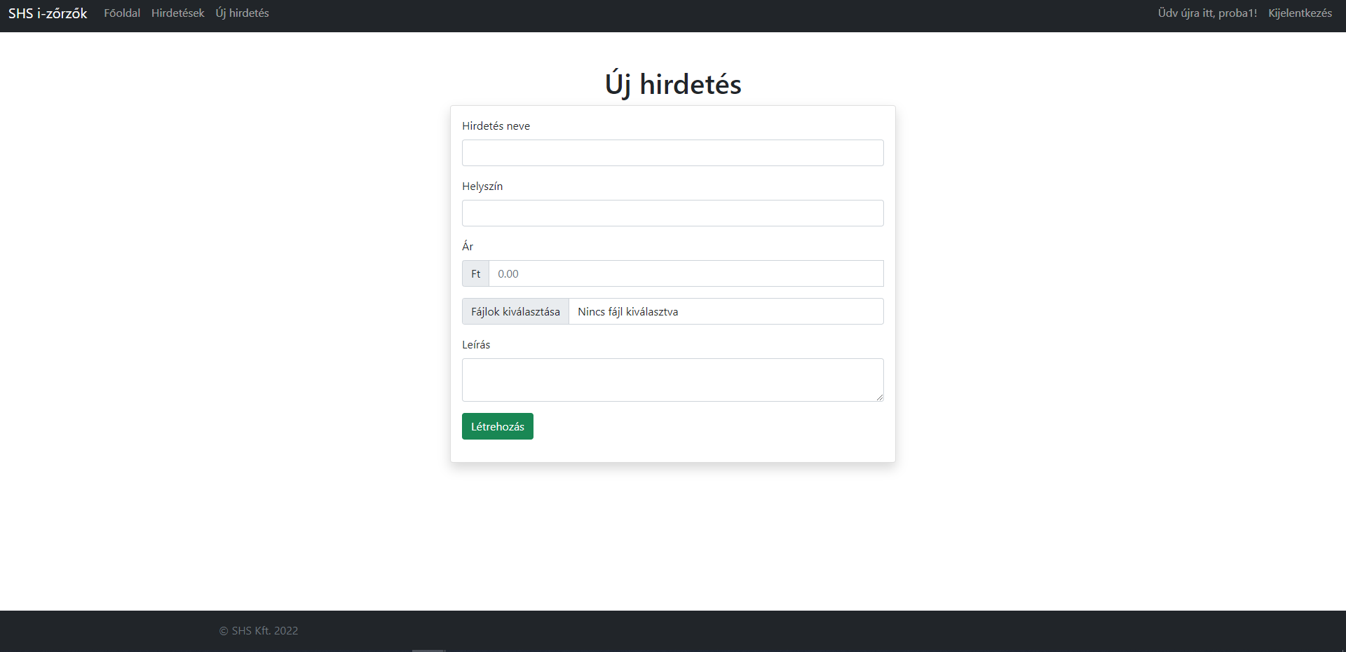
Posting an advertisement

Slide 8
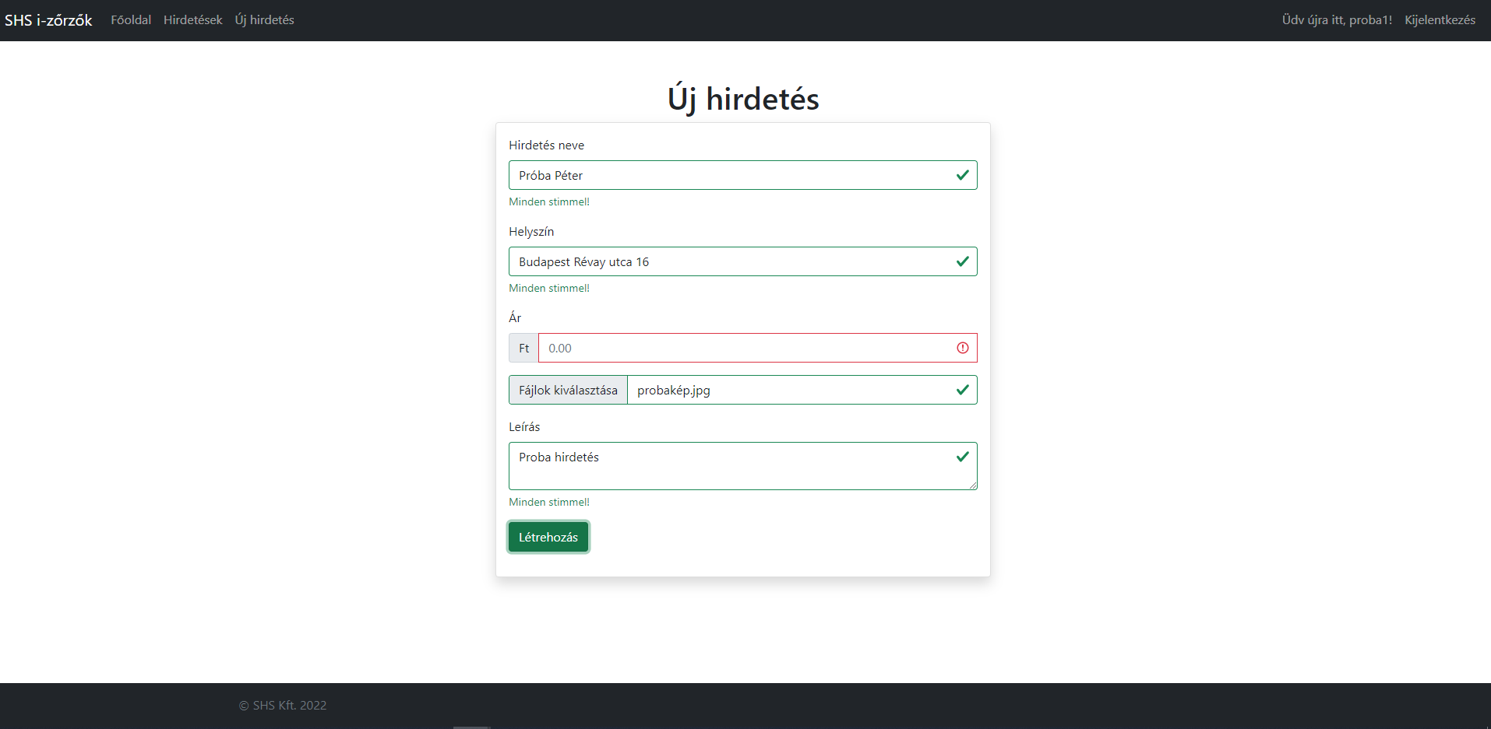
Every single field but ’image uploading’ is mandatory.
All the mandatory fields must be given valid characters, such as price must be numbers or the title of advertisement cannot be an HTML method like alert(”some funny message”).

Slide 9
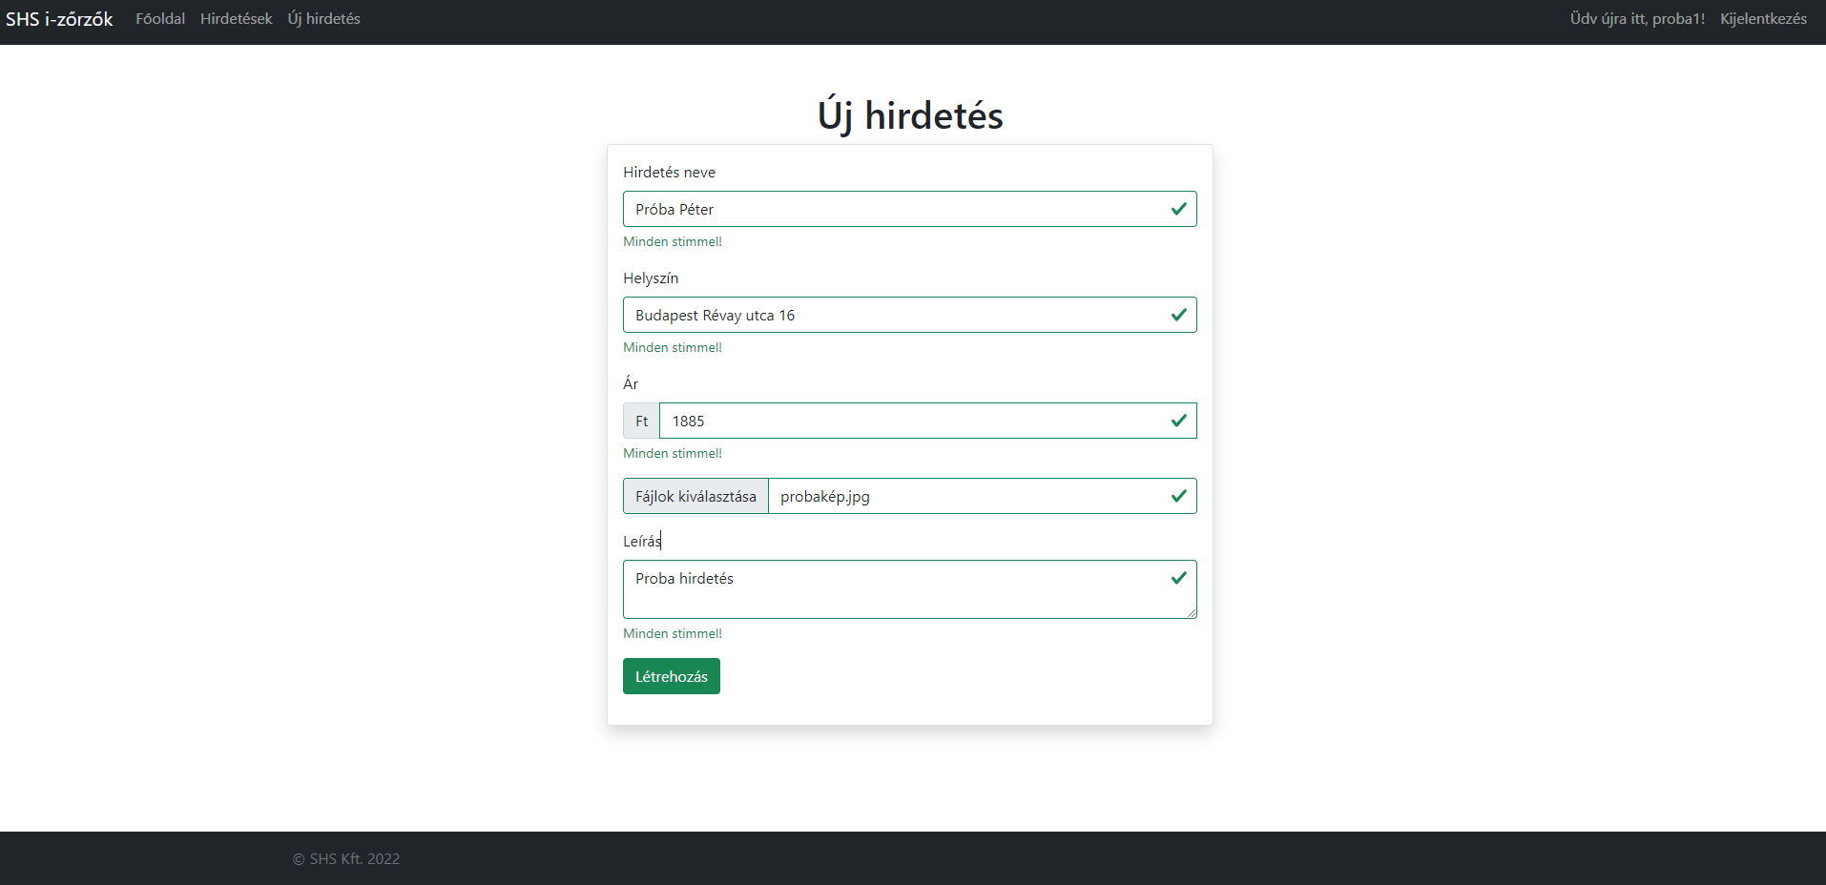
This is how a valid advertisement form looks like.

Slide 10
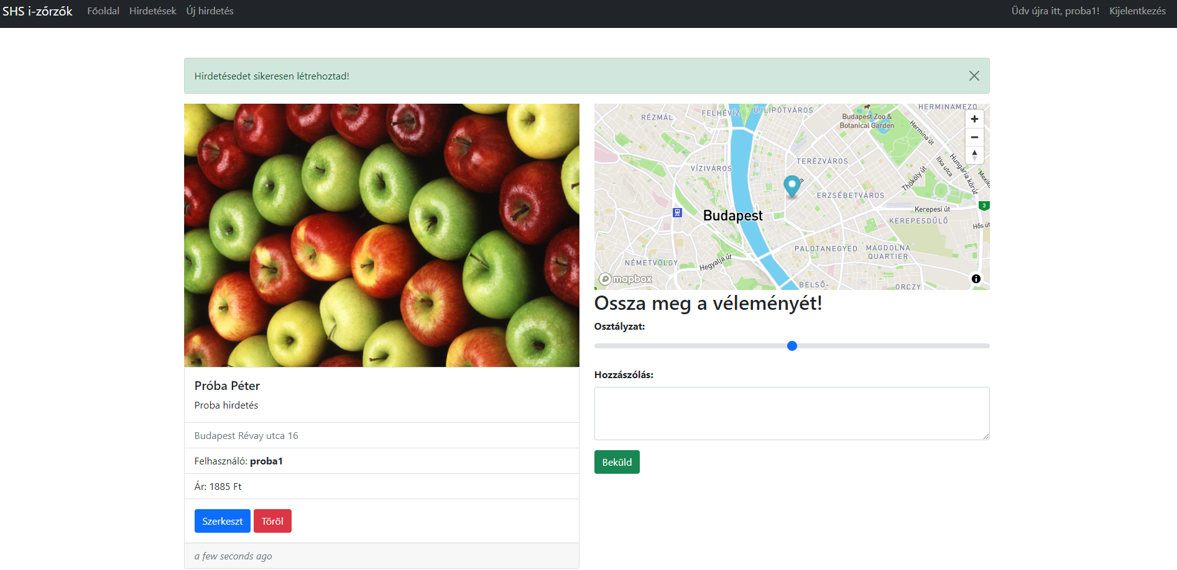
Advertisement structure
A confirmation message if the advertisement has been successfully created
Image(s), if any accessible
Advertisement’s name
Description
Location
User/advertiser’s name
Price
Option to edit and delete it for the author (and admin)
Displays the time the advertisement was posted
Mini map
Can be reviewed by any registered user
Displays the time the review was created

Slide 11
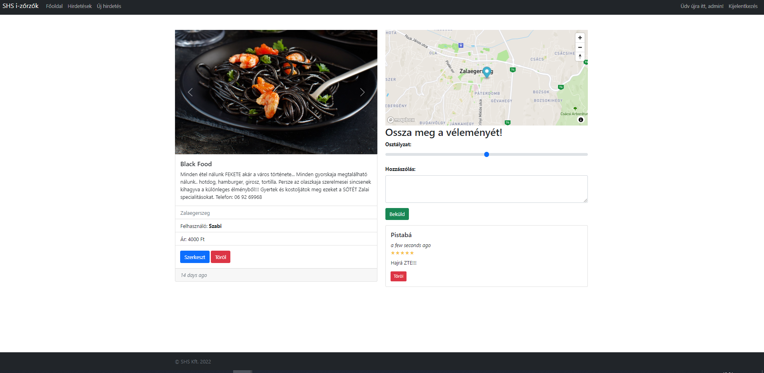
Any advertisement can be modified or deleted by the admin user. Also every single review can be removed by the admin.
https://github.com/SziNo/szabohajduszikora

Slide 12
Thanks for your attention! https://github.com/SziNo/szabohajduszikora

